Slide 1
Understanding the Electorate
Stephen Bookstaber Lauren Lawless
IST 652: Scripting for Data Analysis Final Presentation June 4, 2020

Slide 2
Data Source

Slide 3
DEMOCRACY FUND VOTER STUDY GROUP
From the website (https://www.voterstudygroup.org/about):
“The Democracy Fund Voter Study Group is a research collaboration of more than two dozen analysts and scholars from across the political spectrum examining and delivering insights on the evolving views of American voters.”
“As the 2016 presidential campaign unfolded, it became increasingly clear that the underlying values and beliefs driving voter decisions needed to be better understood. To that end, we convened a politically diverse group of conservative, progressive, and independent public opinion experts to study the electorate together through new primary research. The group seeks not to achieve consensus, but to engage in discussion about how the views of the electorate are evolving and what the implications of those changes may be.”
From the Democracy Fund Voter Study Group documentation:
“The 2019 VOTER Survey (Views of the Electorate Research Survey), completed in January 2019, consists of responses from 6,779 individuals, many of whom participated in prior surveys in 2011, 2012, and 2016. Our unique longitudinal data allow for deep exploration of public opinion on the issues and values that drive voter behavior.”
Citation:
Democracy Fund Voter Study Group. VIEWS OF THE ELECTORATE RESEARCH SURVEY, January 2019. [Computer File] Release 1: [DATE]. Washington, D.C.: Democracy Fund Voter Study Group [producer] https://www.voterstudygroup.org/.

Slide 4
Data Questions

Slide 5
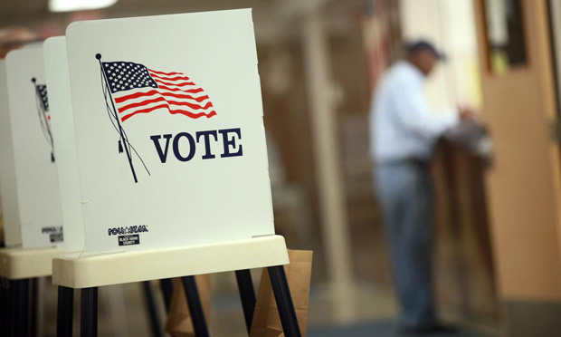
How do people feel about their past voting decision now?
This Photo by Unknown Author is licensed under CC BY-ND

Slide 6
PROCESS
Gather data from survey questions related to emotion and feelings about past voting decisions
# create a list of column names for the relevant columns
Format data
# drop rows containing NaN, convert values to int, and drop nonsensical values of 9 from the redo column and 8 (skipped) from the emotion columns
emo_2019 = df[emo_2019_list].replace(9, np.nan).replace(8,np.nan).dropna().astype(np.int64)
emo_2019.columns = ['angry','anxious','disgusted','sad','hopeful','enthusiastic','vote','regret', 'redo']
emo_2019['regret'] = emo_2019['regret'].astype(str).str.replace('2','0').astype(int)
Calculate values and build data frame
# create a list of the mean value of each question for each candidate
combined = []
for i in cand_dict:
this_df = emo_2019[emo_2019['vote']==cand_dict[i]]
combined.append([this_df[col].mean() for col in this_df.columns])
# combine the list of mean values, candidates names, and emotion columns into a data frame
emo_df = pd.DataFrame(data=combined, index=[i for i in cand_dict], columns=emo_2019.columns)
emo_df.drop(['vote', 'redo'], axis=1, inplace=True)
print(emo_df.to_string()
vote_cols = ['presvote16post_2016', 'regretvote2016_2017', 'redovote2016_2017']
emo_2019_list = [col for col in list(df_2019) if col.startswith('emotion')] + vote_cols
# create dictionary of candidates and corresponding survey values
cand_dict = {'Clinton':1, 'Trump':2, 'Johnson':3, 'Stein':4, 'McMullin':5, 'Other':6, 'No vote':7}
# for regret, 1=Yes, 2=No; for emotions, 1=do not feel at all, 7=feel very strongly
# transform regret column: 1=Yes, 0=No
# drop columns for which .mean() is meaningless

Slide 7
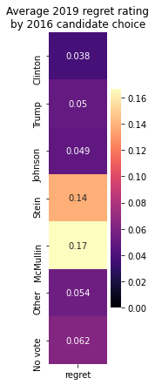
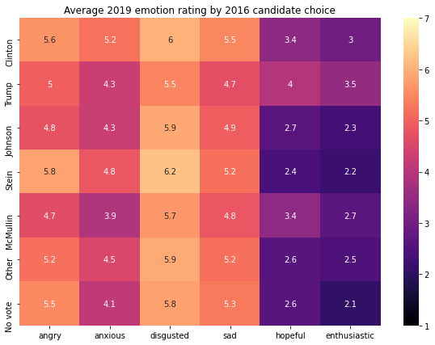
Emotions in Aggregate

Slide 8
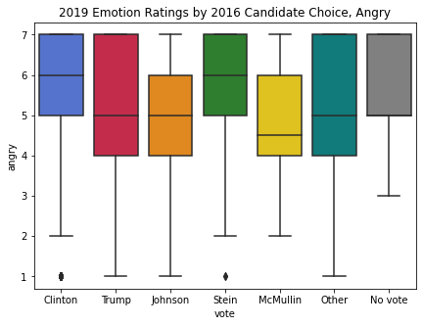
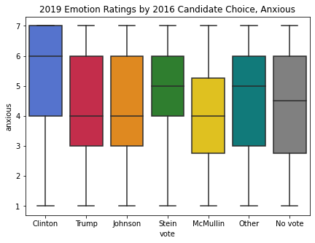
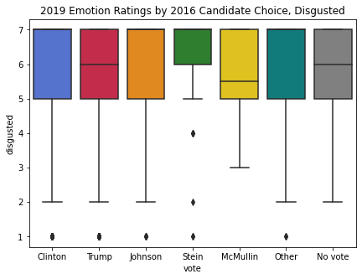
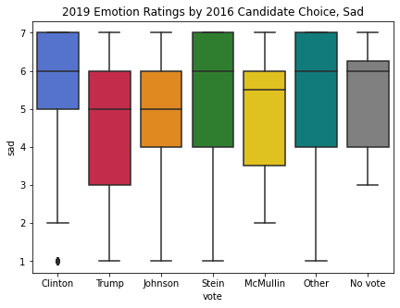
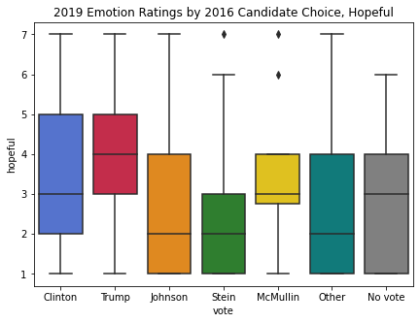
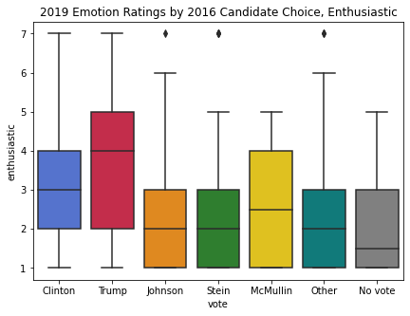
EMOTIONS AS DISTRIBUTIONS

Slide 9

What characteristics inform which candidate a person chooses?

Slide 10
PROCESS
Create subset of required data
Prepare indices of candidates and topics to create multi-index array
def filter_df(df):
# remove columns with open-ended responses
to_remove = ['weight', 'inputstate', 'ft_’,
for substring in to_remove:
df = df[[col for col in df.columns if substring
for col in df.columns:
for val in df[col].unique():
if type(val) == str:
df.drop(col, axis=1, inplace=True)
break
return df
df_2016 = filter_df(df_2016)
'regzip', 'fav_', 'Sanders', 'Rubio', 'Cruz']
not in col]]
# remove columns that have string type responses
index1 = []
index2 = []
for candidate in cand_dict:
for col in df_2016.columns:
index1.append(candidate)
index2.append(col)
topic_df = pd.DataFrame(index = [index1, index2])
topic_df.index.set_names(['Candidate', 'Topic'], inplace=True)

Slide 11
PROCESS, CONT.
Calculate proportion of answers for each topic (index 1) and candidate (index 2)
for cand in cand_dict:
this_df = df_2016[df_2016['presvote16post_2016']==cand_dict[cand]]
for topic in this_df.columns:
# normalize gives the proportion of total answers
answer = this_df[topic].value_counts(normalize=True)
# list of possible answers to this question
possible_answers = answer.index.astype(np.int64)
# list of the proportion of responses for each possible answer
responses = list(answer)
# insert the answer proportions at the index corresponding to this candidate and topic
for idx, ans in enumerate(possible_answers):
topic_df.loc[(cand, topic), ans] = responses[idx]
# now, topic_df is a multi-index data frame, where each column is a possible response
topic_df = topic_df.reindex(columns=sorted(list(topic_df)))
topics = list(df_2016)

Slide 12
PROCESS, CONT.
Prepare indices of candidates and topics to create multi-index array
divisive_df = pd.DataFrame()
divisive_topics = []
for topic in topics:
# example of subsetting topic_df indices for each topic and keeping only Clinton and Trump
this_topic_df = topic_df[topic_df.index.get_level_values('Topic').isin([topic]) &
topic_df.index.get_level_values('Candidate').isin(['Clinton', 'Trump'])].dropna(axis=1)
# create list of the absolute value of differences between Trump and Clinton answer proportions
diffs = [abs(this_topic_df.iloc[0,i] - this_topic_df.iloc[1,i]) for i in range(len(list(this_topic_df)))]
# if the difference of any column is above 0.5, the topic is considered divisive
if any(diff > .5 for diff in diffs):
divisive_topics.append([topic])
# drop columns with value > 4, as these are responses that are either erroneous or indecisive
this_topic_df.drop([col for col in list(this_topic_df) if col > 4], axis=1, inplace=True)
this_topic_df = this_topic_df.reset_index()
# prepare the data frame for visualization
divisive_df = divisive_df.append(this_topic_df,ignore_index=True)
# create heatmap
sns.heatmap(this_topic_df.drop(columns={'Topic'}).set_index('Candidate'),vmin=0,vmax=1,annot=True,cmap='magma')
plt.title('Question ID: '+this_topic_df['Topic'].max())
plt.show()

Slide 13
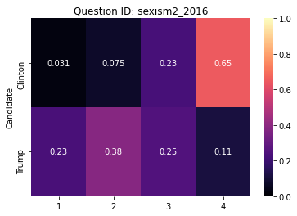
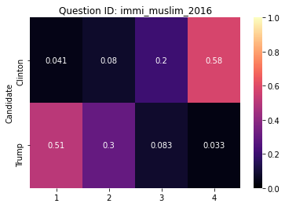
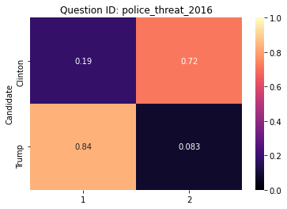
SOCIAL ISSUES
Gender
Gender equality
LGBTQ+ rights
Race
Affirmative action
Police killings
Immigration
Muslim ban
Naturalization
Benefits of diversity
Wealth inequality
Redistribution of wealth
Trust in media

Slide 14
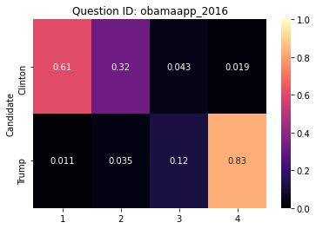
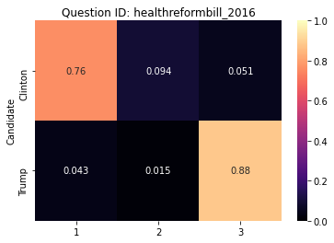
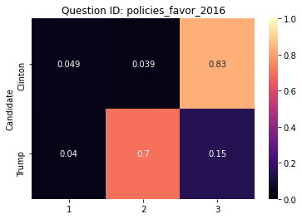
POLICY ISSUES
Size of government
Healthcare
Affordable Care Act
Universal healthcare
Obama approval
Policy favoritism
Environment & climate
Taxes

Slide 15
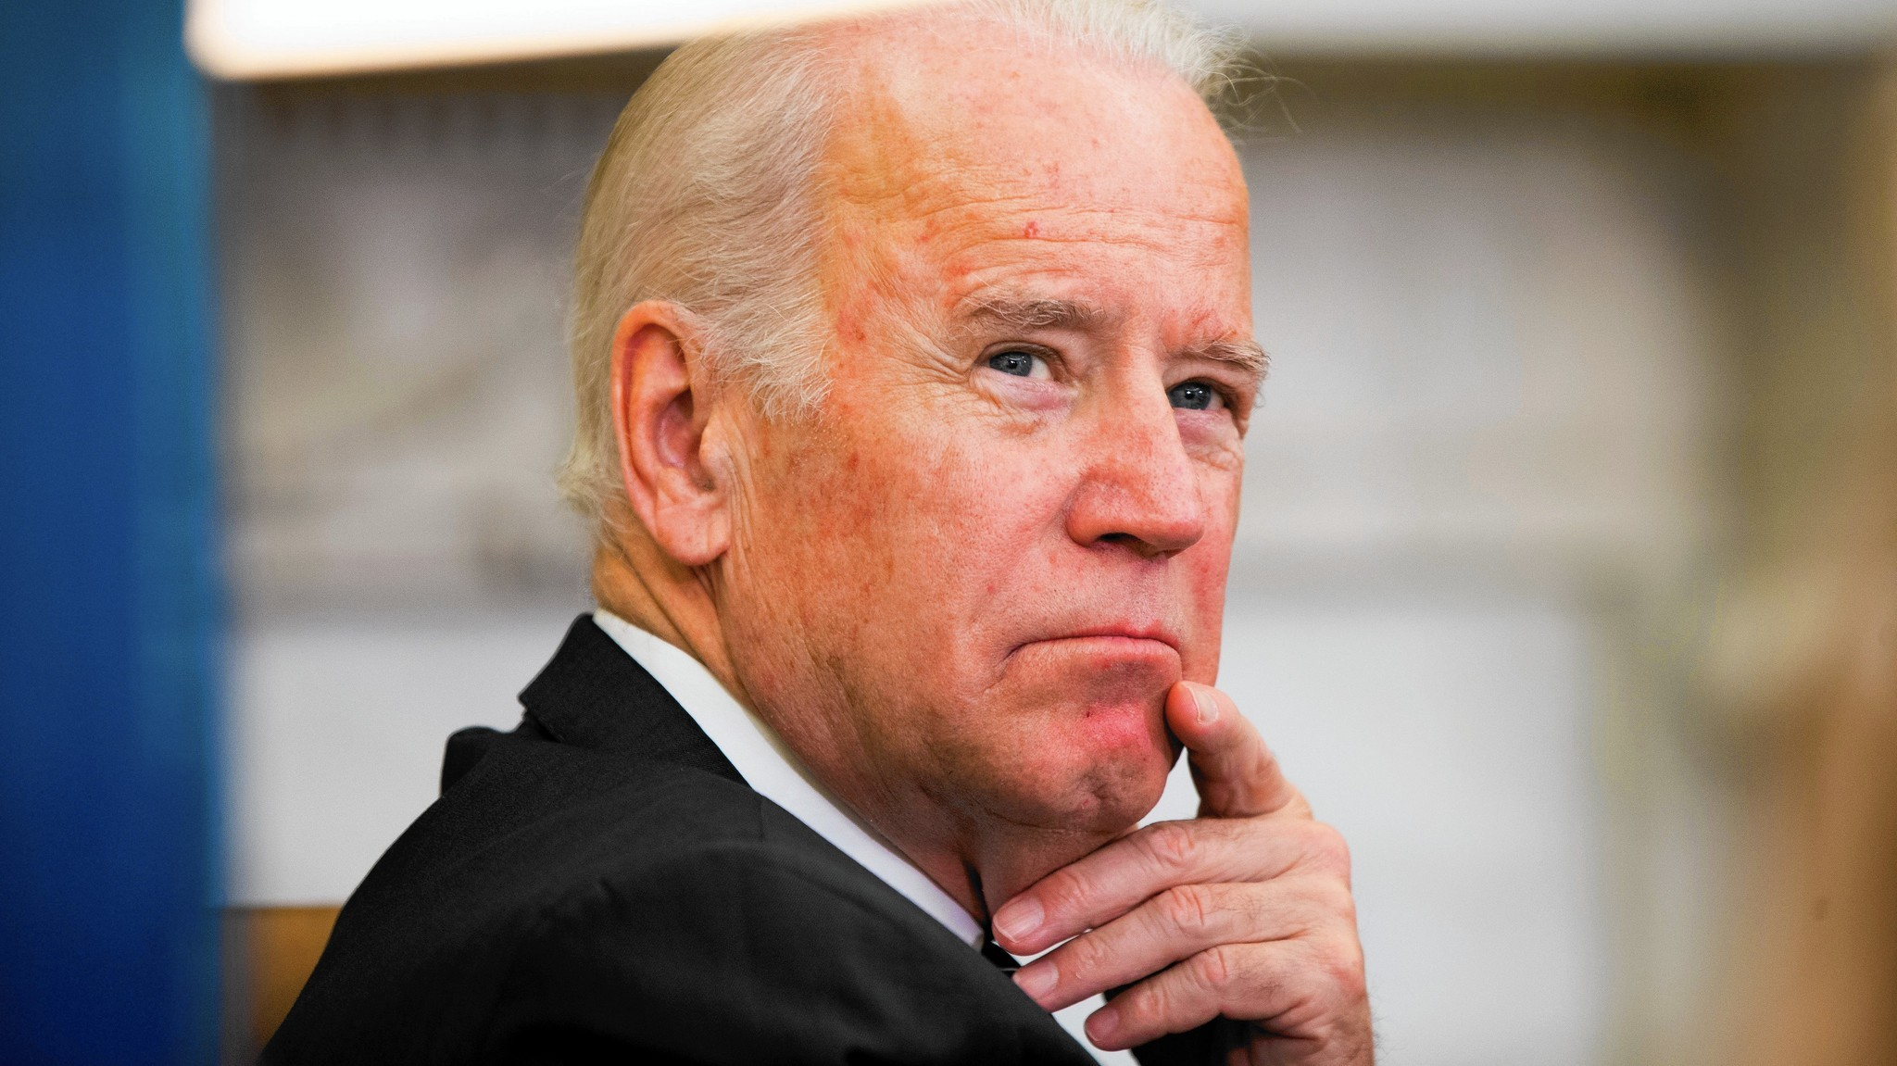
Can this data inform how people might behave in 2020?

Slide 16
PROCESS
Gather relevant data
# drop columns that are directly related to party/candidate
Handle missing values
def prep_lr_df(df):
df_lr_2016 = df_2016.drop(['turnout16_2016','vote_usual_2016','pp_primary16_2016', 'pp_demprim16_2016', 'wished_voted_2016', 'pp_repprim16_2016', 'free_trade_5_2016', 'obamaapp_2016', 'pid7_2016’, 'second_chance_2016', 'ideo5_2016', 'vote2016_cand2_2016', 'votereg2_2016'] + [col for col in list(df_2016) if col.startswith('PARTY')], axis=1)
# comment out to keep party ID column in data; uncomment to remove
df_lr_2016 = df_lr_2016.drop(['pid3_2016'],axis=1)
# condition y by selecting only Trump and Clinton voters, then convert 2 (voted for Trump) to 0 so that y is binary (0,1)
df_lr_2016 = df_lr_2016[df_lr_2016['presvote16post_2016'].isin([1,2])]
df_lr_2016['presvote16post_2016'] = df_lr_2016['presvote16post_2016'].replace(2,0)
'''prep_lr_df performs preprocessing to prepare the data frame for model use'''
# remove rows for which the 2016 presidential vote is missing
df_lr = df.dropna(subset=['presvote16post_2016'])
# remove rows that are completely empty
df_lr = df.dropna(axis=0, thresh=1).reset_index().drop(['index'], axis=1)
# use IterativeImputer to preprocess/handle NAs
imp = IterativeImputer(max_iter=1000, random_state=0)
df_lr = imp.fit_transform(df_lr)
# redefine the data frame with the imputed data
df_lr = pd.DataFrame(columns=list(df), data=df_lr)
return df_lr
df_lr_2016 = prep_lr_df(df_lr_2016)

Slide 17
PROCESS, CONT.
# seperate inputs (x) from output (y)
x = df_lr_2016.drop('presvote16post_2016', axis=1)
y = df_lr_2016['presvote16post_2016']
# threshold max_p_val, and repeat until x consists only of significant variables
ready = False
while not ready:
sig_preds = []
# perform regression and derive statistics
x2 = sm.add_constant(x)
est = sm.OLS(y, x2)
est2 = est.fit()
# create list of significant input variable names based on their corresponding p-value
sig_preds = [est2.pvalues.index[i[0]] for i in enumerate(est2.pvalues) if i[1] < max_p_val]
# recreate x by dropping non-significant inputs
to_drop = [col for col in list(x) if col not in sig_preds]
# check if the list is empty; if not, drop the variables listed
if to_drop:
x = x.drop(to_drop, axis=1)
else:
ready = True
Identify significant inputs for model
# perform regression, identify and drop variables with p-value above the

Slide 18
PROCESS, CONT.
Split into train and test sets, and run model
# separate out train and test data
x_train, x_test, y_train, y_test = train_test_split(x,y,random_state=50,train_size=0.45)
# create the logistic regression model
model = LogisticRegression(max_iter=10000)
# apply the model to the train data
model = model.fit(x_train, y_train)
y_test_pred = model.predict(x_test)
# create summary of model variables
x_train_intercept = x_train.copy(deep = True)
x_train_intercept['intercept'] = 1
logmodel_vars = sm.Logit(y_train,x_train_intercept)
result = logmodel_vars.fit()
Create correlation matrix
corr_df = x_train.corr(method='pearson')
threshold = .5
for col in list(corr_df):
for row in corr_df.index:
if abs(corr_df.loc[row, col]) > threshold and corr_df.loc[row, col] != 1:
print(row, col, corr_df.loc[row, col])

Slide 19
PROCESS, CONT.
Apply to 2019 data for 2020 prediction
# identify columns in the 2016 dataframe that were repeated in 2019
repeated_topics_2016 = []
repeated_topics_2019 = []
for col in x.columns:
col_2019 = col[:-1]+'9'
if col_2019 in df_2019.columns:
repeated_topics_2016.append(col)
repeated_topics_2019.append(col_2019)
# add 2016 vote choice and anticipated 2020 vote choice to list of columns to collect
repeated_topics = ['presvote16post_2016','vote2020_2019'] + repeated_topics_2016 + repeated_topics_2019
# create a new small data frame that contains these columns
df_sml = df[repeated_topics]
df_sml = df_sml[df_sml['presvote16post_2016'] <= 2] # only people who voted Clinton (1) or Trump (2) in 2016
df_sml['presvote16post_2016'] = df_sml['presvote16post_2016'].replace(2,0) # transform Trump values to 0 instead of 2 for use in logistic regression
df_sml = df_sml.dropna() # drop rows containing null values
df_sml['vote2020_2019'] = df_sml['vote2020_2019'].replace([3,4,8],np.nan).replace(1,0).replace(2,1) # replace 2020 votes for neither Trump nor the Democrat with null; transform Trump value from 1 to 0 and Democratic candidate value from 2 to 1
# split into 2016 attributes (x), 2019 attributes (x), and 2016 vote (y)
x_2016_sml = df_sml[repeated_topics_2016]
x_2019_sml = df_sml[repeated_topics_2019]
y_2016_sml = df_sml['presvote16post_2016']
# split into train and test sets, with random state set for repeatable results; model was run multiple times to optimize train size
X_train_sml, X_test_sml, y_train_sml, y_test_sml = train_test_split(x_2016_sml, y_2016_sml, random_state=50, train_size=0.45)
model_sml = LogisticRegression(max_iter=10000)
model_sml = model_sml.fit(X_train_sml, y_train_sml)
pred_2020 = model_sml.predict(x_2019_sml)

Slide 20
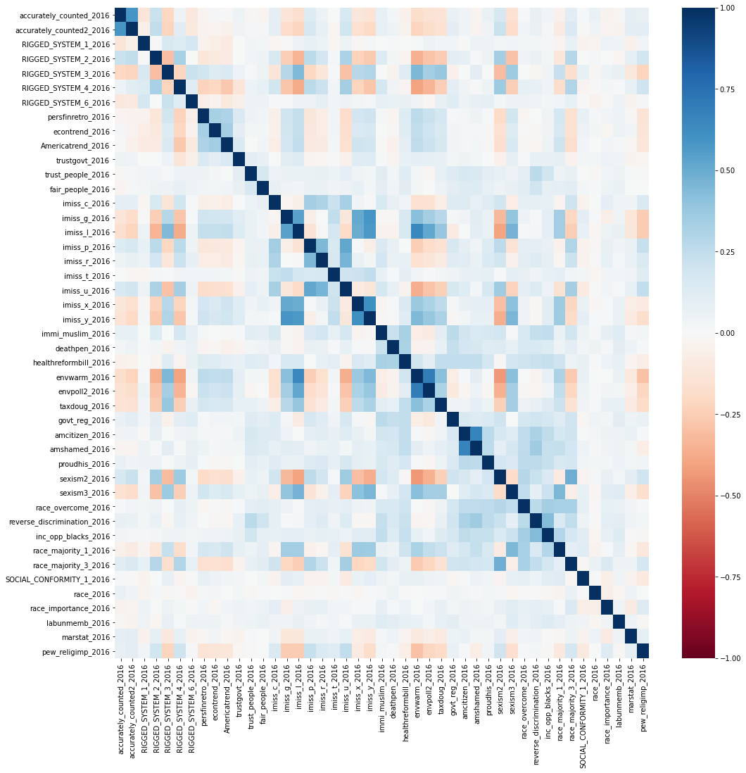
EVALUATE VARIABLE IMPACT WITH LOGISTIC REGRESSION: 2016 PREDICTION
45 significant variables
Pseudo R2 = 0.7639
Accuracy: 93.09%
 |  | Predicted
 |  | Trump | Clinton
Actual | Trump | 1,755 | 159
 | Clinton | 109 | 1,858

Slide 21
REPEATED QUESTIONS MODEL: 2020 PREDICTION
20 variables
Personal finances, taxes, and economy
Trust in/size of government
Immigration
Healthcare
Gender and LGBTQ+
Race
Marital status
Religiosity
2016 Test Accuracy: 90.45%
Model prediction of proportion of voters who will choose the Democratic candidate in 2020:
53.70% (2802 votes)
Actual proportion of respondents who would choose the Democratic candidate in 2020 over Donald Trump:
52.54% (2541 votes)

Slide 22

CONCLUSIONS
People are still fired up about 2016
Certain topics are more divisive than others
People reliably use divisive topics to decide on a candidate

